Slide 1
HUMAN FACE EMOTION IN 3D
Batch -08
Shaik Mohammed Sameer 1602-20-737-168
Jarupla Aruna 1602-20-737-125
Chimmi Mahesh 1602-20-737-143

Slide 2

Contents
Abstract
Description About Project
Use Case Diagram
Description About Models
Training
Different use cases
Output screenshots
Technology used
Future Scope
References

Slide 3
PROBLEM STATEMENT
With the recent advancement of computer vision and AI/ML techniques, identification of human faces is no longer a challenging task. However, creating a human face with captured expressions, movements, voice and other features in real time images is still a challenging task. Design a prototype system with advance techniques of image recognition and AI/ML to identify humans in real time image. The prototype system must render the image of identified person in the image such that the face orientation changes dynamically with the body movement. Effects like face expressions, movements must be captured effectively to give feeling of real human face.

Slide 4
Abstract
>> Face detection, which is an effortless task for humans, is complex to perform on machines. The interaction between human beings and computers will be more natural if computers are able to perceive and respond to human non-verbal communication such as emotions.
>> This project uses a combination of techniques in two topics; face detection and recognition. The first step is detection of face in sequential frames containing face. Emotions are reflected from speech, hand and gestures of the body and through facial expressions. The main objective of this project is to make a webapp to upload an image to detect emotions and make a 3d render face.

Slide 5
Description about project
>> We create a model using keras modelling, execute and train it for human face detection and emotion analysis with the help of machine learning algorithm CNN.
>> Our project CNN model has 6 layers of filtering and trained with kaggle dataset fer2013 which has around 33,000 pictures classify into 7 classes.
>> User has to upload image then the system will predict the emotion using trained model.

Slide 6
Description about project
>> For making 3d model we use Basel Face Model (2017) which provide the dataset and pretrained model.
>> Whole process of making 3d face using BFM pretrained model
needs GPU.
>> After predicting emotion the image will be send to BFM model which will make it into 3d.

Slide 7
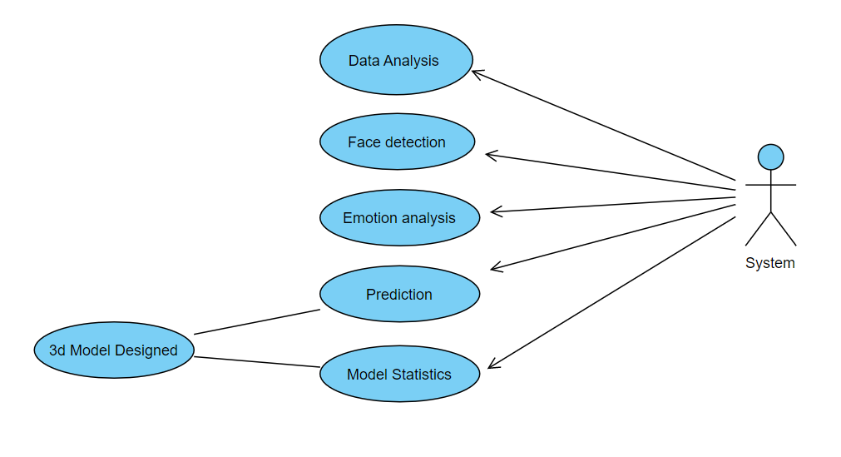
Use Case Diagram

Slide 8


Description About Models
>> Data Analysis:
Image converting into grayscale using CV2
Resizing gray Image to 48x48 pixels
Reshaping image using Numpy

Slide 9
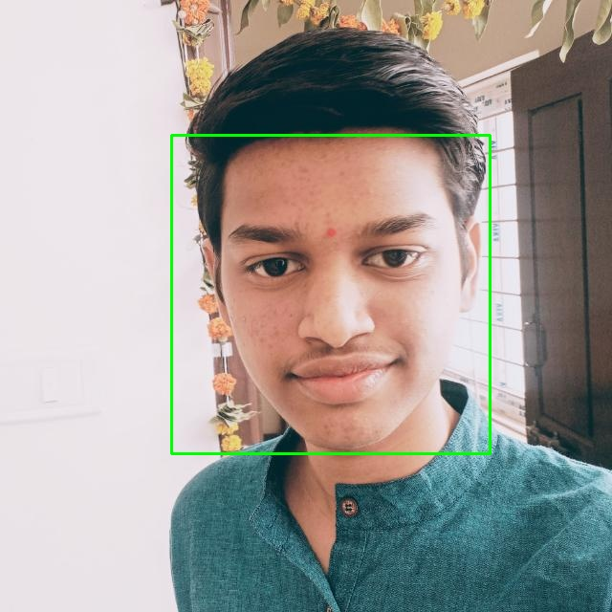
Description About Models
>> Face Detection:
Detecting faces using “haarcascade_frontalface_default.xml”.
Cropping image to face shape.

Slide 10
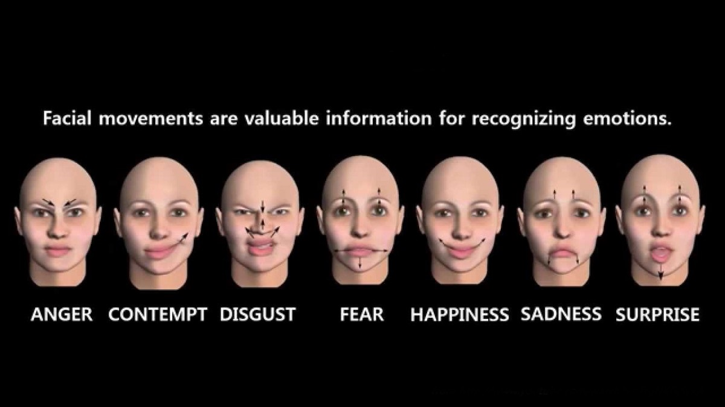
Description About Models
>> Emotion Analysis:
Loading model structure using json file.
Predicting emotion using CNN trained model (model.h5)

Slide 11
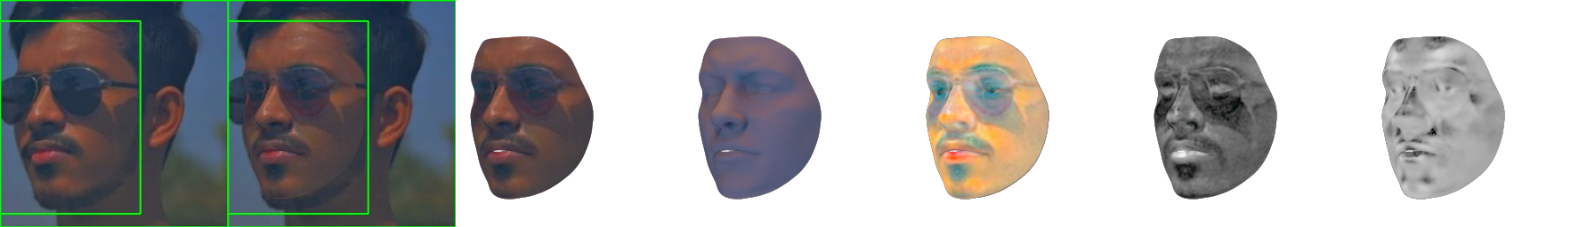
Description About Models
>> 3D Model :
Loading BFM model for making 3d face using torch, aspose-3d and mediapipe.

Slide 12
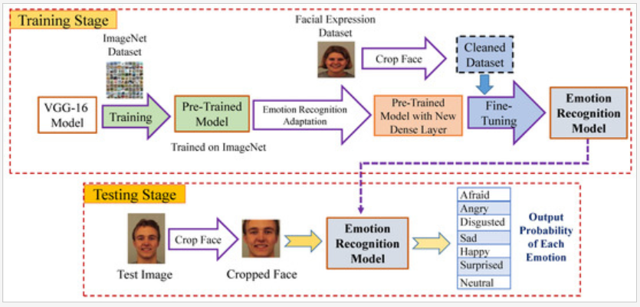
Training
FER 2013

Slide 13
Use Cases
Use Case-1:
Name : Upload Image
Actors : User
Description : Allows user to upload image
Pre-Conditions : take a picture
Post-Conditions : image will be uploaded
USER | SYSTEM
upload an image
click submit
 | image is uploaded take to next page

Slide 14
Use Cases
Use Case-2:
Name : Upload image
Actors : User
Description : Allows user to upload image
Pre-Conditions : take a picture
Post-Conditions : if image not uploaded redirect to same page
USER | SYSTEM
no image uploaded
click submit
 | redirect to same page

Slide 15
Use Cases
Use Case-3:
Name : Predict
Actors : System
Description : Predict emotion of uploaded image
USER | SYSTEM
 | take uploaded image and load trained model
 | predict the emotion of image
 | display to user

Slide 16
Use Cases
Use Case-4:
Name : Make 3d face
Actors : System
Description : Make a 3d face of image using BFM
USER | SYSTEM
 | take uploaded image and load BFM trained model
 | convert image face into 3d face
 | display to user

Slide 17
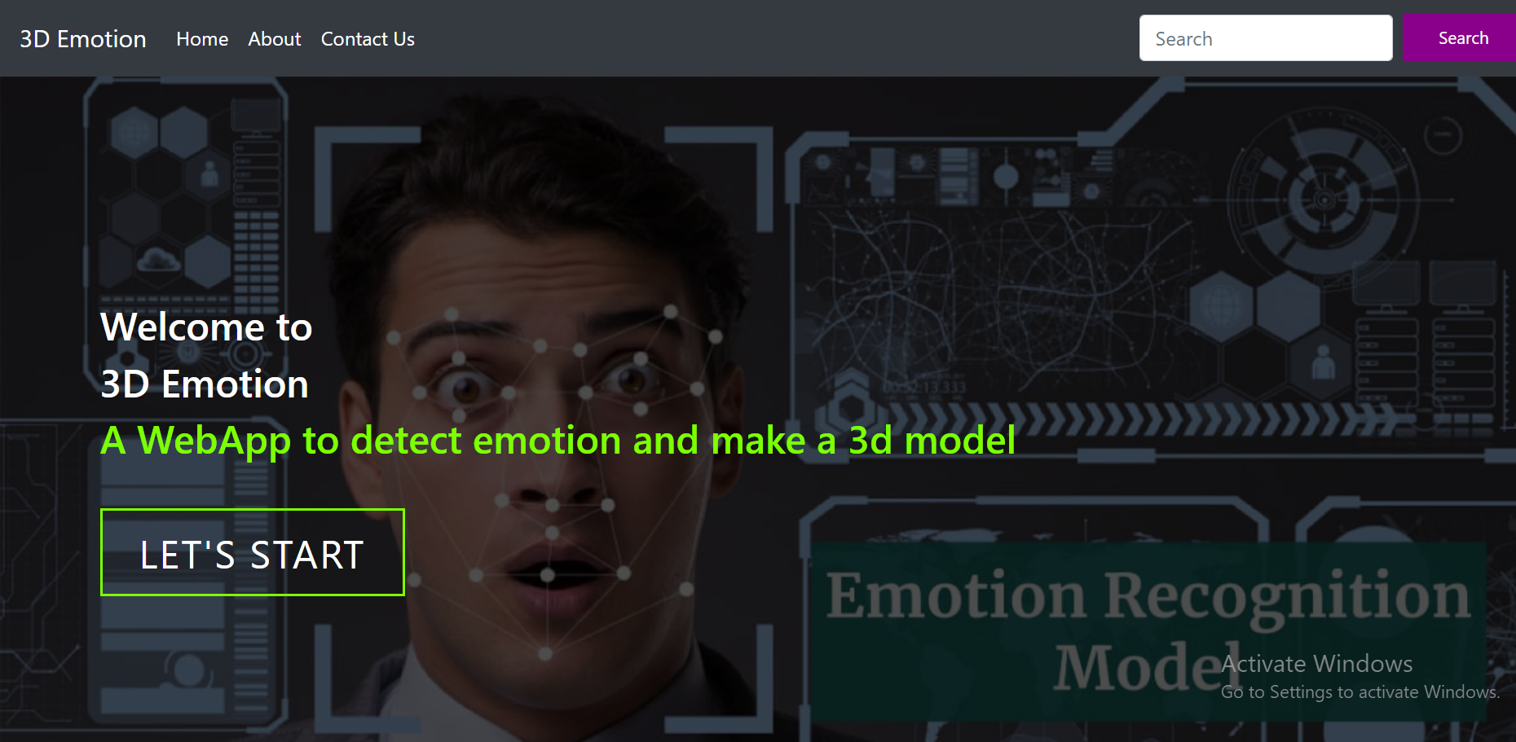
Output Screenshots

Slide 18
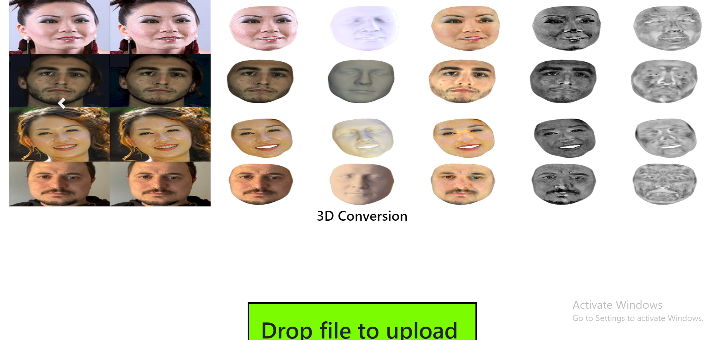
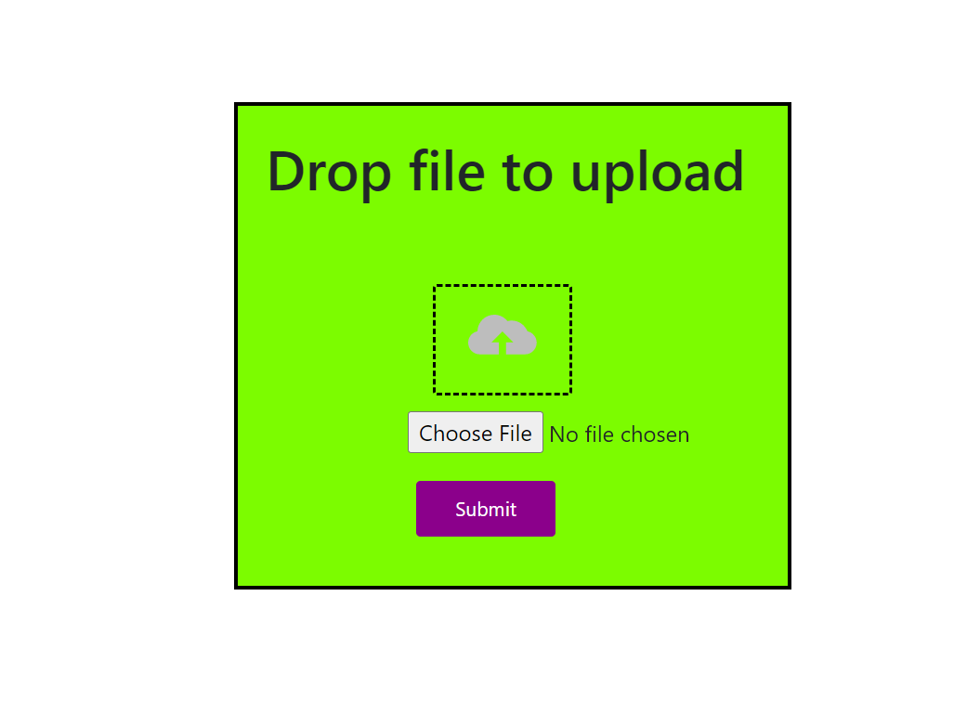

Slide 19
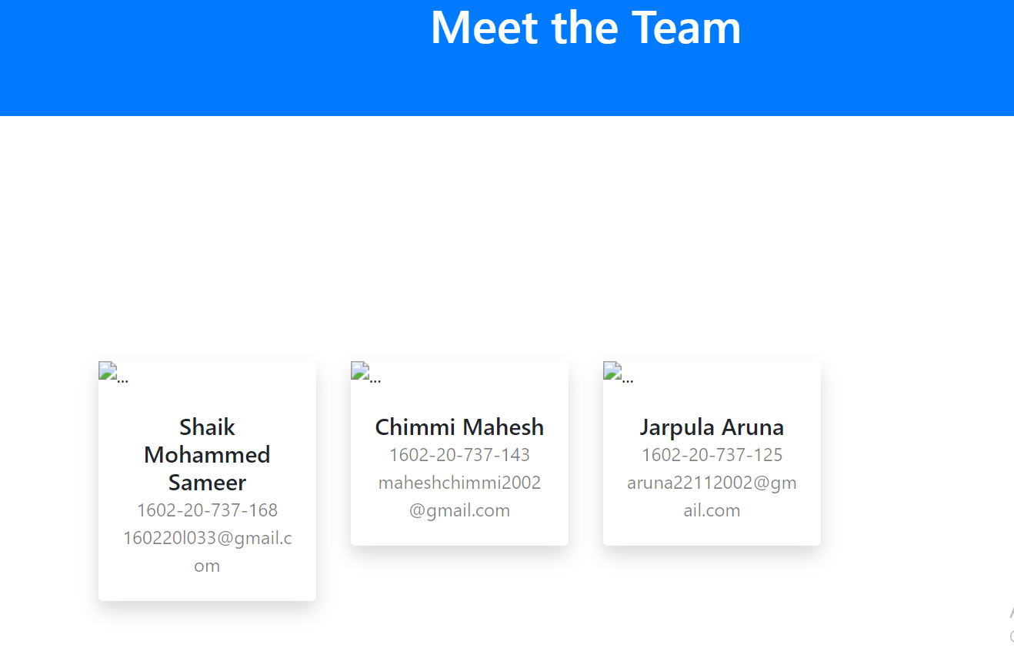
ABOUT US

Slide 20
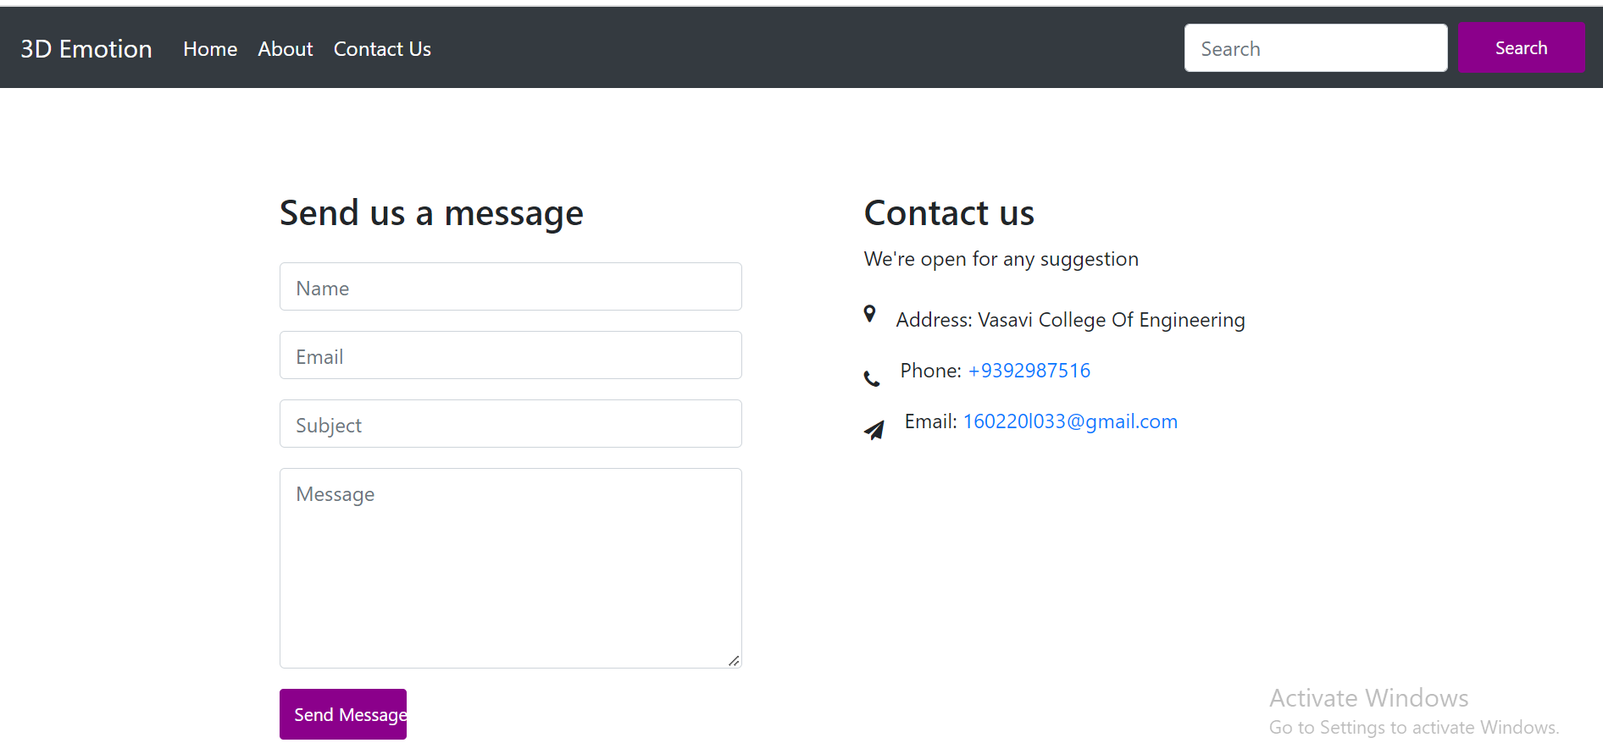
Contact Us

Slide 21
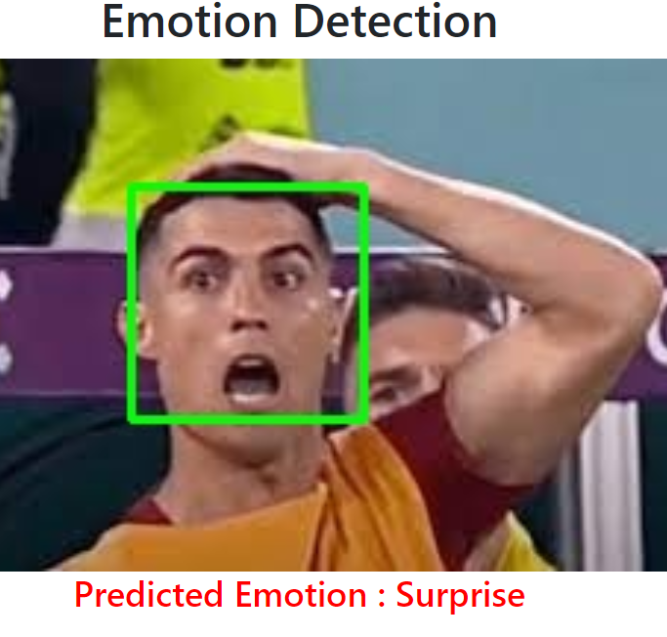
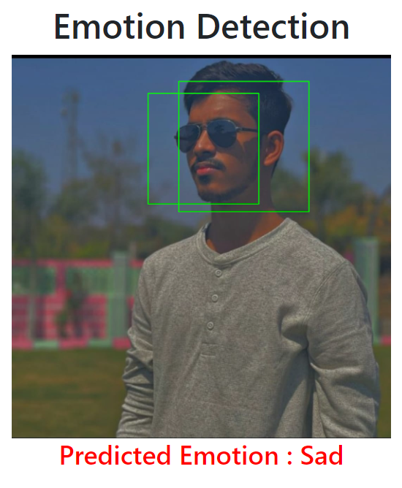
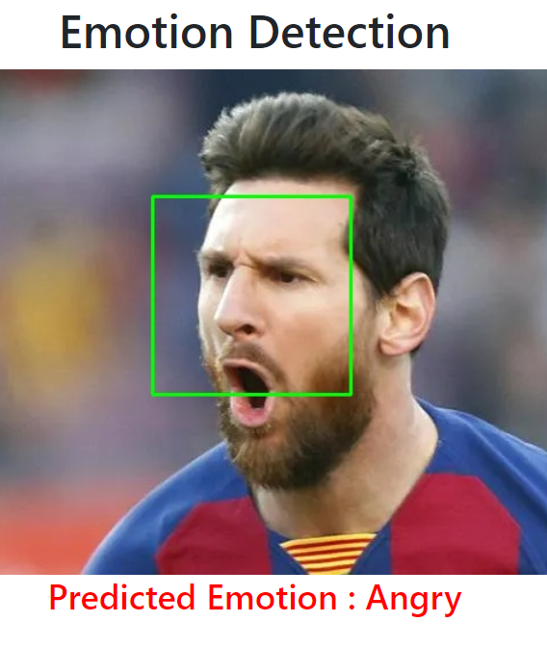
Result

Slide 22
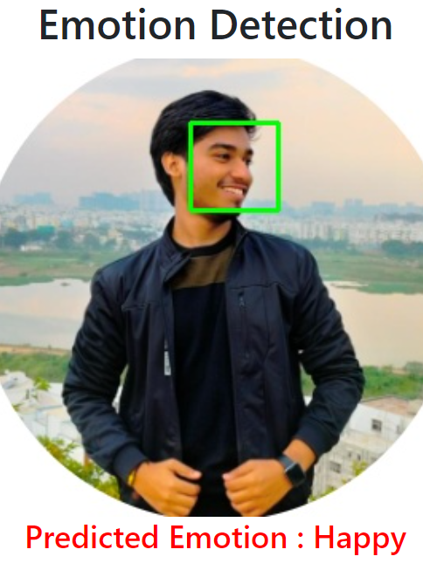
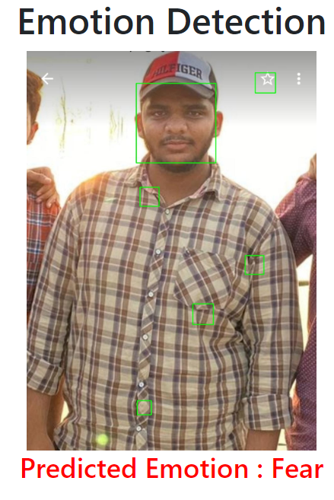
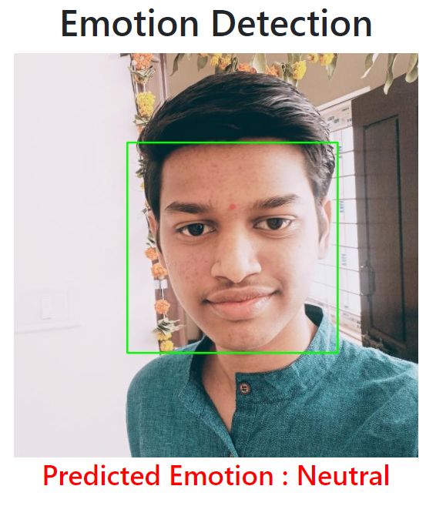
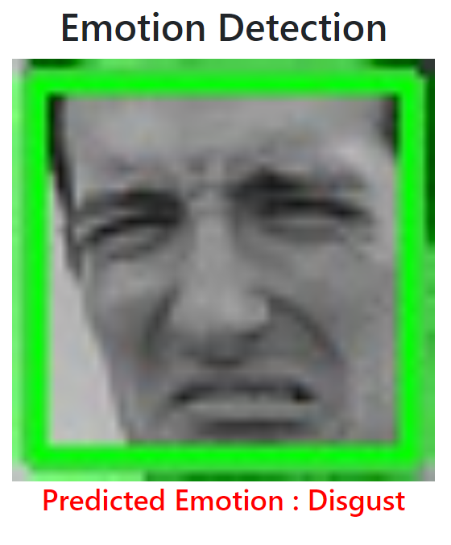
Result

Slide 23
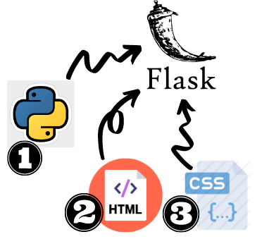


Technologies Used
IDE : VS CODE,Google Colab
Data Set : Emotion Detection ( FER_2013) from kaggle,BFM model
Modules : Keras , CNN
Technologies Used : HTML,CSS, FLASK ,PYTHON

Slide 24
Future Scope
we will make android application
Improving 3d model efficiency.
Option of taking picture real time.

Slide 25
References
https://www.kaggle.com/datasets/msambare/fer2013
https://towardsdatascience.com/a-comprehensive-guide-to-convolutional-neural-networks-the-eli5-way-3bd2b1164a53
https://www.javatpoint.com/keras
https://www.geeksforgeeks.org/opencv-python-tutorial/
https://faces.dmi.unibas.ch/bfm/bfm2017.html
https://www.tutorialspoint.com/flask/index.html

Slide 26

THANK YOU

